Slide 1

Arcade Snake Game
{
< Ben Theurich, Carter Rath, Cody McKinney >
}
...
Notes:
Carter 1

Slide 2
Table of Contents
01
02
03
Project Concept
Introduce the project aim, relevance, and similar works
Development
Review our components, circuit design, PDL, flow graph, and implementation details
Reflection
Challenges, testing, results, and references
Notes:
Carter 2

Slide 3
01
Project Concept
{
..
< Introduce the project aim, relevance, and similar works >
}
..
Notes:
Carter 3

Slide 4
Project aim and relevance
Our aim was to use our knowledge of embedded systems, like writing digits to a display, receiving analog input, handling interrupts, and using the Mbed API to replicate a classic game that can be played in real-time with user interaction.
This gives us the opportunity to combine several different concepts we have learned throughout the course into a functioning project. Our project also provides video game enthusiasts the chance to build themselves their own classic SnakeGame using five simple parts.
}
..
Notes:
Carter 4
The relevance of this project is that we are providing a schematic for video game enthusiasts to build themselves

Slide 5
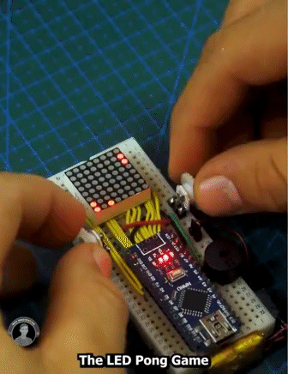
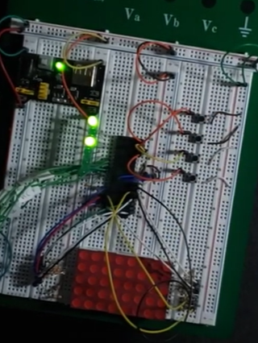
Similar works
{
..
}
..
Notes:
Carter 5
For similar works, we saw this pong game on instagram and were inspired to use an led matrix to create a classic game. We decided to go with the snake game. At the bottom, this is an implementation of snake game that we found on youtube, that uses 4 buttons to control the snake’s movements. Our’s differs because we are using a joystick and a speaker to play game noises

Slide 6
02
Development
{
..
< Review our components, circuit design, PDL, flow graph, and implementation details >
}
..
Notes:
Ben 1

Slide 7
Necessary Components
LED Matrix
...
8x8 LED Matrix display with an integrated MAX7219 display driver. Uses Serial Peripheral Interface (SPI).
Joystick
Piezo Speaker
Dual axis joystick with a select button for user input. Uses AnalogIn and Interrupts.
Buzzer speaker for game sounds. Uses Pulse Width Modulation (PWM).
Notes:
Ben 2

Slide 8
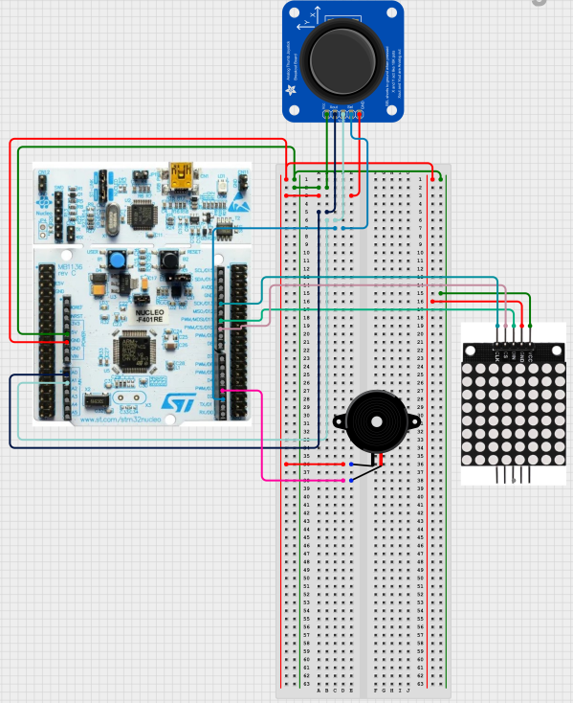
Circuit Diagram
}
< Circuitry Design of all components >
*
Notes:
Ben 3

Slide 9

PDL
BEGIN
Declare pins for the MAX7219 LED display driver
Declare pins for the Joystick
Declare the game board object
Configure the LED display
Enable the LED display
Start Launch Game animation
DO FOREVER
Click joystick to start game
Create new game board
Play Start Game animation
While game is not over While game is paused
Wait
Get direction of Snake from joystick
Move Snake
Check game status and end if game is lost
Update game board
If Snake consumes fruit
Grow Snake
Update score
Loop through rows of game board
Convert each row vector from binary to decimal
Write 1s to the row of LED display according to decimal value
Play end game animation when user loses
ENDDO
END
*
Notes:
Ben 4

Slide 10
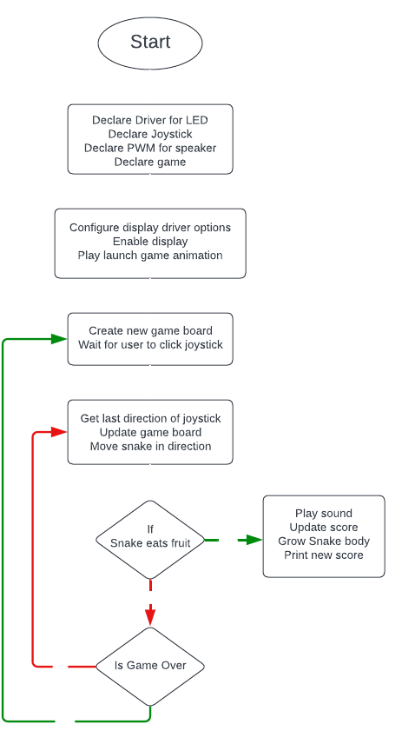
Flowchart Diagram of Main
*
Notes:
Carter 3

Slide 11
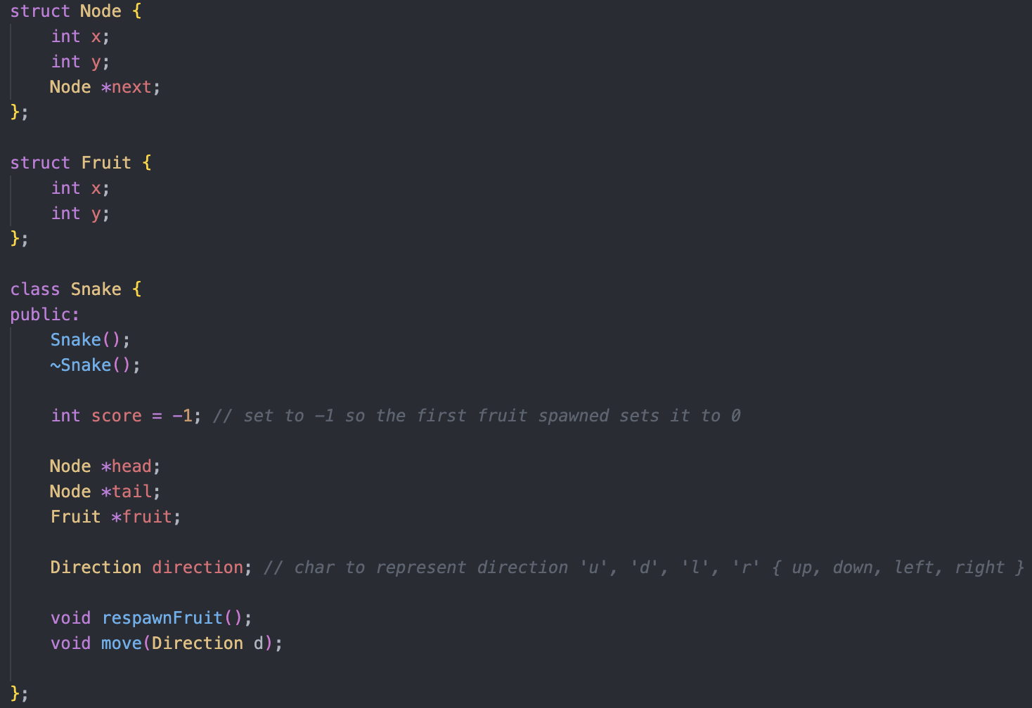
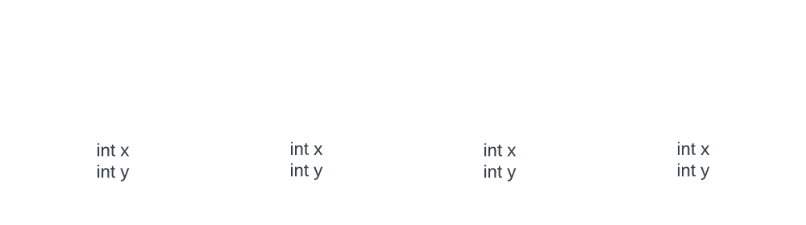
Implementation
Details Snake.cpp
For the Snake object, we are using a linked list to track each body part. When the Snake moves, we add a node to the head and remove the tail.
When the Snake eats a fruit, we move the snake forward by one without removing the tail.
*
Notes:
Cody 1

Slide 12
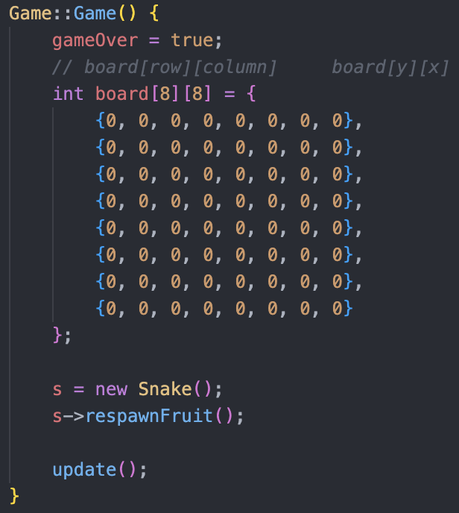
Implementation
Details Game.cpp
For the Game object, we are using a 2D array to represent the board imposed on the 8x8 Matrix.
When constructing the board, we also create a Snake object, spawn a fruit and call update, which places the Snake in the top left corner. When the Snake moves, we update the rows and columns of the board.
*
Notes:
Cody 2

Slide 13
03
Results
{
..
< Challenges, testing, results, and references >
}
..
Notes:
Cody 3

Slide 14
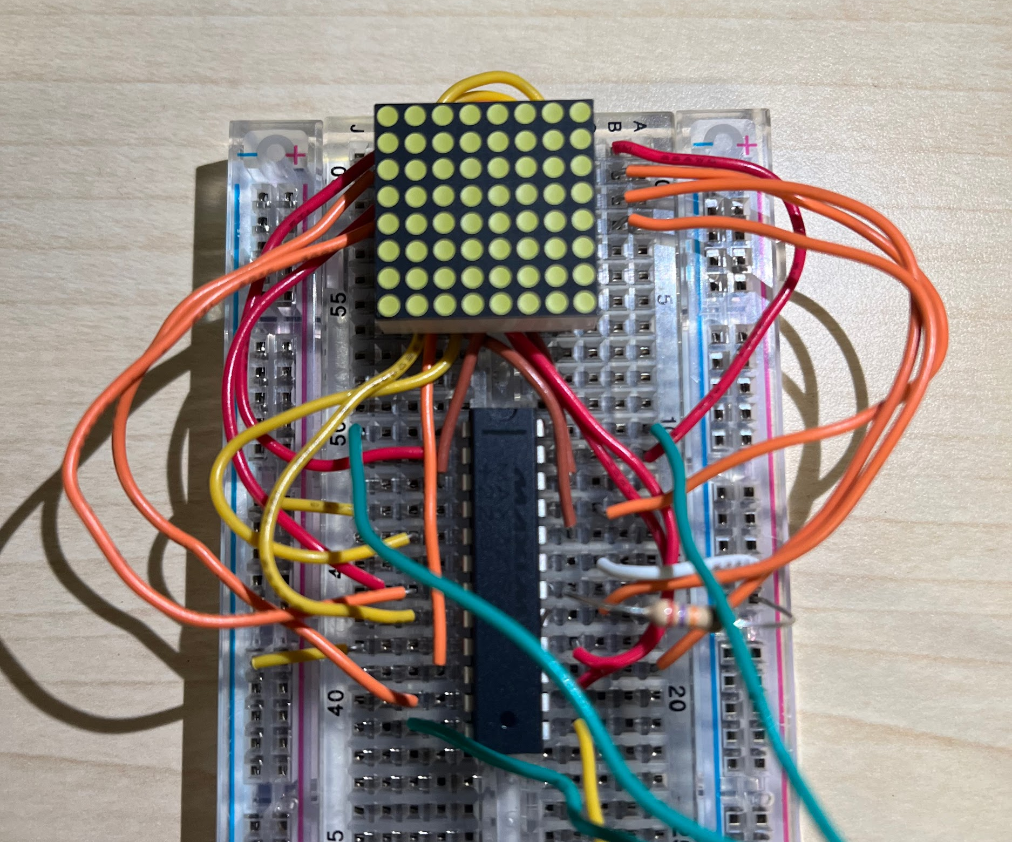
Challenges Faced
{
We initially started off using an 8x8 LED matrix without the display driver attached to it. Understanding how the MAX7219 interacted with the LED matrix was very time consuming and took a lot of connections.
Ultimately, we decided to go with a new matrix peripheral that had the driver already integrated. This made the setup much more simple and gave us a larger screen to work with.
}
Notes:
Cody 4

Slide 15
Testing
{
< Lots of run throughs of the game while developing >
}
Notes:
Cody 5

Slide 16
Future Additions
LCD Screen
Potentiometer
The LCD screen could be added to display the score.
Potentiometer could be used to vary the difficulty / speed of the Snake movement on the LED matrix.
Notes:
Ben 5

Slide 17
Ben
Carter
Cody
Snake collisions with itself and the wall. Death screen animation. Fruit spawning. Piezo speaker.
Snake object. Game board logic. Joystick logic. Launch game animation. Wire connections. Painted the base.
Research. Snake object. Game board logic. Joystick logic. Wire connections.
Notes:
Carter
For group contribution, Over the past couple of years working together in other classes, we became great friends, so we had no problem meeting in person to get this project completed and we had quite a few late nights in the engineering building.

Slide 18
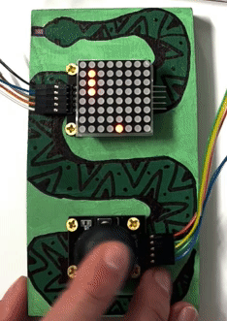
See our Demonstration
Notes:
All of us <3

Slide 19
References
{
..
[1] “MAX7219 | Mbed,” os.mbed.com. https://os.mbed.com/teams/Maxim-Integrated/code/MAX7219/docs/tip/classMax7219.html (accessed Apr. 21, 2023).
‌
[2] “Serially Interfaced, 8-Digit LED Display Drivers” [Online]. Available: https://cdn-shop.adafruit.com/datasheets/MAX7219.pdf (accessed Apr. 21, 2023).
[3] ArduinoModules, “KY-023 Dual Axis Joystick Module,” ArduinoModulesInfo, May 21, 2018. https://arduinomodules.info/ky-023-joystick-dual-axis-module/ (accessed Apr. 21, 2023).
‌
[4] S. Lagishetty, “8x8 LED Matrix MAX7219 with Arduino Circuit & Code,” How To Electronics, Jan. 06, 2020. https://how2electronics.com/8x8-led-matrix-max7219-arduino/ (accessed Apr. 21, 2023).
[5] “Joystick | Mbed,” os.mbed.com, May 05, 2016. https://os.mbed.com/teams/ELEC2645-201516/code/Joystick/docs/tip/ (accessed Apr. 22, 2023).
[6] max.imagination, “Arduino Project - 8x8 LED Pong Game,” Instagram, Jan. 27, 2023. https://www.instagram.com/reel/Cn61hkIDx5c/?igshid=YmMyMTA2M2Y= (accessed Mar. 23, 2023).
[7] Kevger, “GitHub - Kevger/MBed-STM32-Snake: Snake für den STM32 Nucleo-L031K6 mit MBed OS. Visualisierung durch ein 8x8 LED Matrix Display.,” GitHub. https://github.com/Kevger/MBed-STM32-Snake (accessed Apr. 22, 2023).
[8] Carlos Miranda, “Embedded Systems: Snake Game,” YouTube. Jun. 07, 2021. [Online]. Available: https://www.youtube.com/watch?v=vg8U1FO0HE0 (accessed Apr. 22, 2023).
*
}
..

